Slide 1


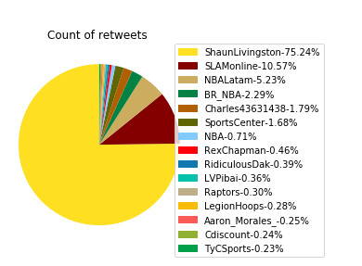
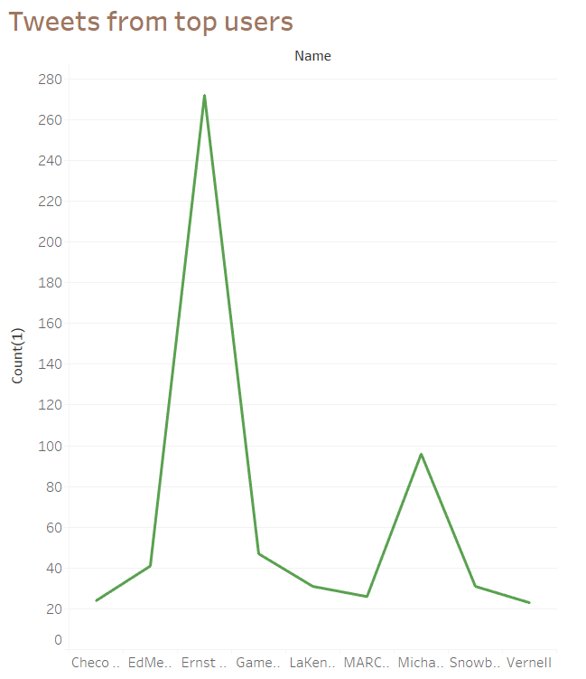
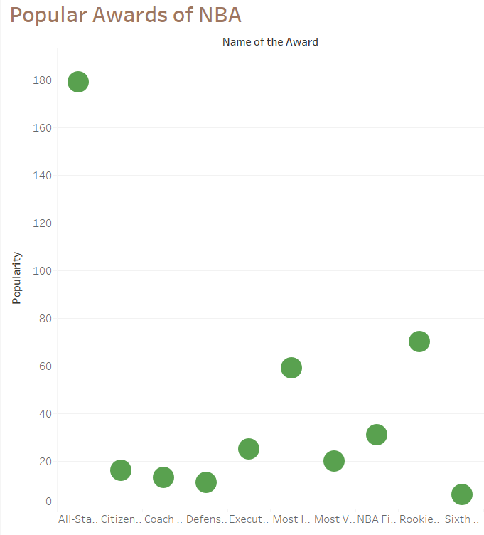
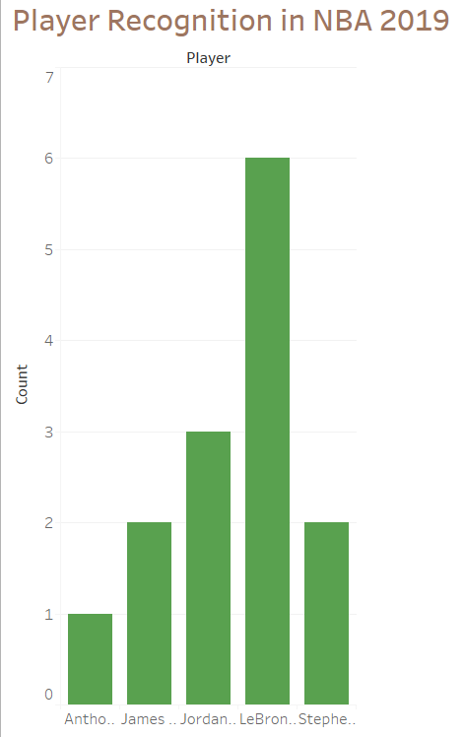
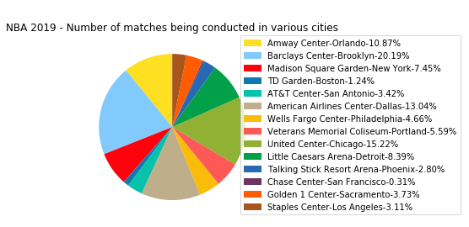
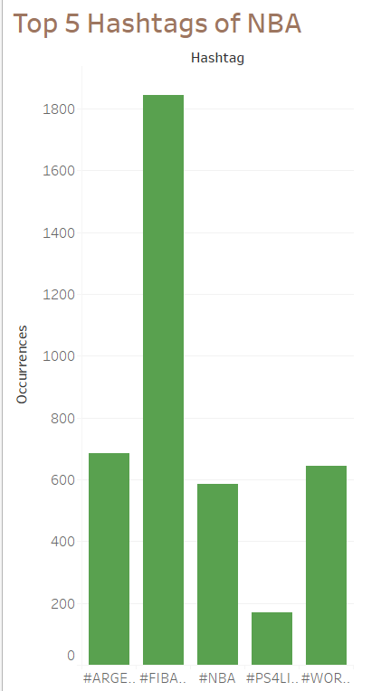
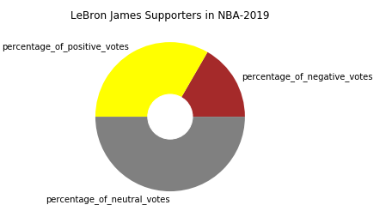
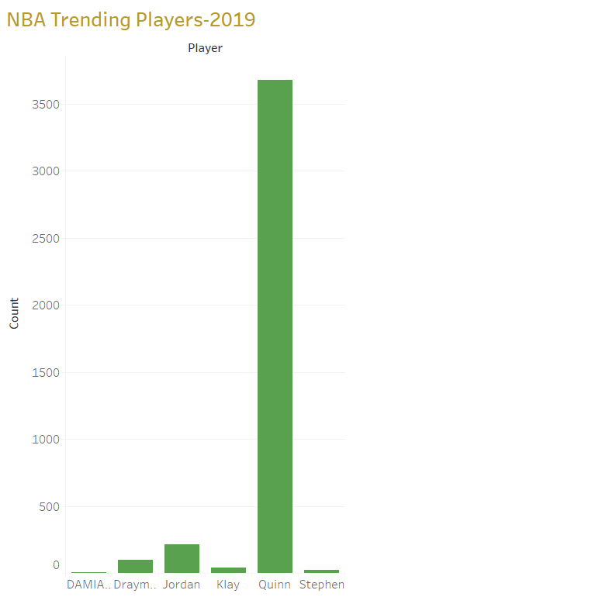


PRINCIPLES OF BIG DATA MANAGEMENT Twitter Data Analysis National Basketball Association(NBA)
Abstract
Technologies: Python, Spark
Tools: Spyder, Tableau
Conclusion: We get the insights by analyzing and visualizing the twitter data on sports like from what places in the world tweet about sports and more. Who are talking about sports more and what exactly on sports they tweet about
1.Performing analysis on the twitter data being collected by the means of various queries.
2. Visualization of data
Count of Retweets
Tweets from top Users
Top Players of NBA 2019
Result :
The 75.24% of Retweets are from ShaunLivingston and the rest 25% is other countries.
Result :
Ernst Nordholt has tweeted the highest number of tweets while Checo tweets were the least
Result :
Chris Paul and Kevin Durant are the top players
Popular Awards of NBA
Player Recognition In NBA 2019
NBA 2019-Number of Matches being Conducted in Various Cities
Result :
Popular Award of NBA, The most popular goes to All-star Game MVP
TOP 5 HASHTAGS OF NBA
Result :
Jordan is most recognized player in NBA 2019
Result:
Most matches hosting city is BCB with 20.19%
LeBron James supporters in NBA-2019
List of trending players of NBA
Tweets From Top 20 Languages
Result:
Top 5 Hashtags of NBA is for FIBAWC and its 1800
Result:
Displaying the supporters and hatters of LeBron James in NBA-2019 and the visualization using Donut Pie-Chart.
Result:
Trending players of NBA Quinn and Jordan.
Result:
Among Top 20 Languages tweets, the most tweets are from English Language.
Team:
Vamsi Draksharam-16291789
Sai Charan Kottapalli -16247878
Divya Reddy Bandari – 16281700
Under the Guidance
Praveen Rao, Ph.D
Associate Professor

